Slide 1
Smart Expense Tracker with Money Wastage Analysis
Batch :- 11
Reg.no:- 241FA04253
241FA04722
241FA04F39
241FA04F51

Slide 2
Introduction
Managing personal expenses is essential for financial stability
Many individuals fail to monitor daily spending accurately
Lack of awareness leads to money wastage
This project proposes a smart solution to overcome these issues

Slide 3
Abstract :-
The Smart Expense Tracker helps users record and analyze daily expenses to identify money wastage. It makes budgeting easier and helps improve saving habits.
Objective of the project:-
The main objective of this project is to help users record daily expenses, analyze spending habits, and identify money wastage.
It aims to make users aware of unnecessary expenses and help them save money and plan their budget effectively.

Slide 4
Existing System:-
In the existing system, people usually write expenses in notebooks, remember expenses mentally, or use simple notes on mobile phones. There is no automatic calculation or analysis of expenses.
Disadvantages of Existing System:-
Manual entry is time-consuming
High chance of calculation errors
No clear idea about money wastage
Difficult to track expenses category-wise
Data can be lost or forgotten

Slide 5
Proposed System:-
The proposed system is a web-based Smart Expense Tracker developed using HTML, CSS, and JavaScript. Users can easily add expenses, view total spending, and analyze money wastage based on categories. The system also provides tips to reduce unnecessary spending.
Advantages of Proposed System:-
Easy to use and user-friendly
Automatic expense calculation
Identifies high and unnecessary spending
Saves time and reduces errors

Slide 6
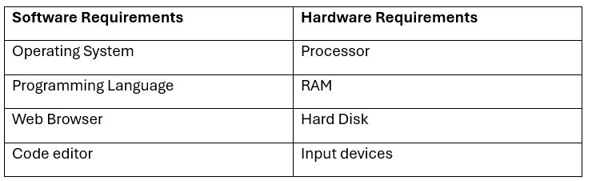
Software and Hardware Requirements:-

Slide 7
Completion of Literature Survey
Studied traditional methods of expense management
Reviewed existing mobile and web-based expense trackers
Analyzed research papers on financial behavior
Understood limitations of current systems

Slide 8
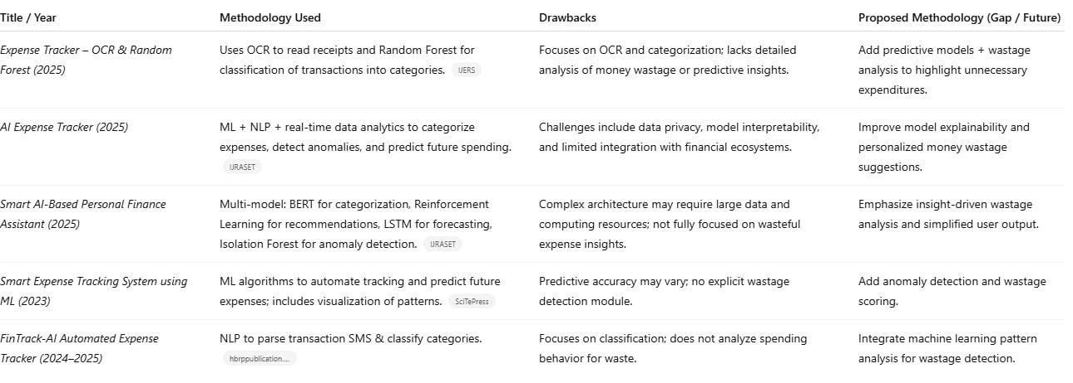

Slide 9
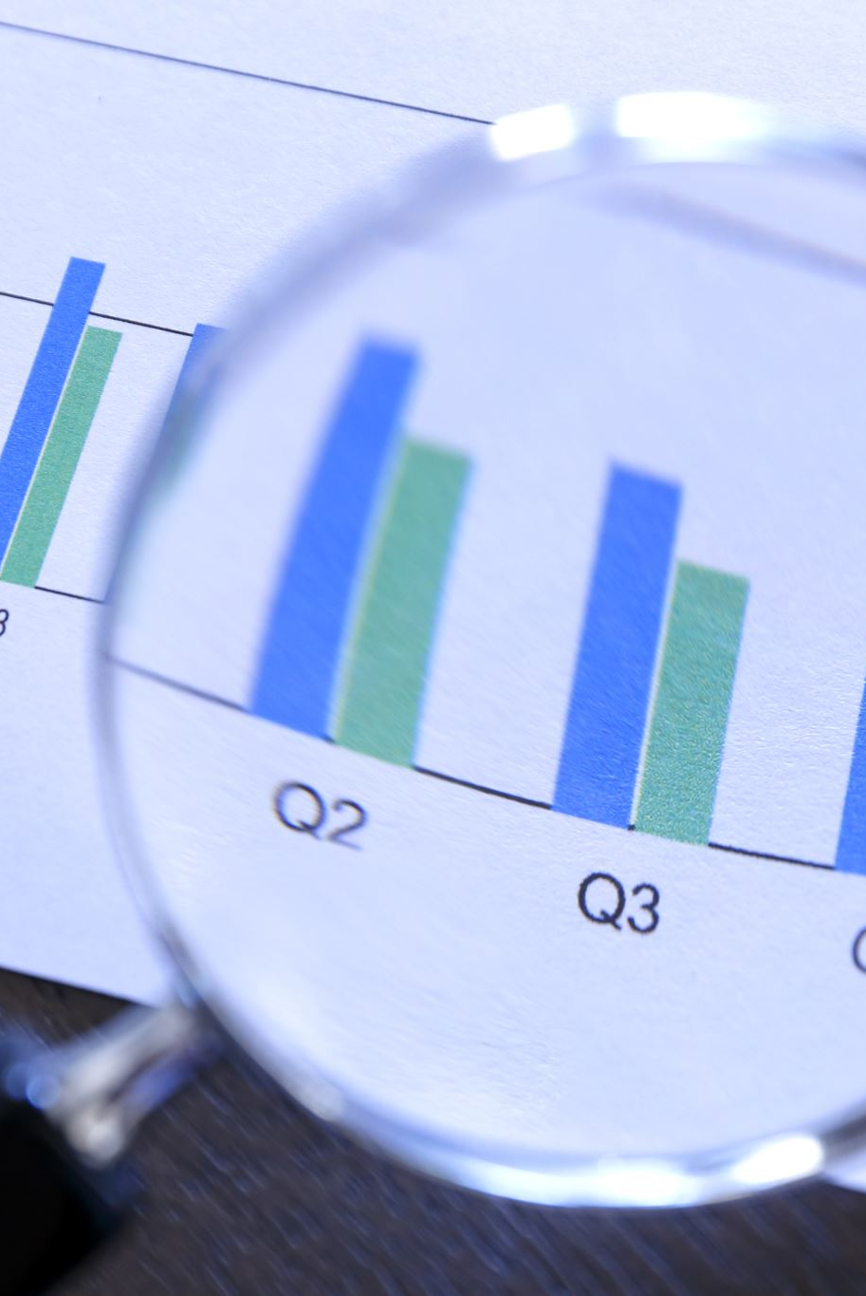
Problem Identification
Difficulty in tracking daily expenses accurately
No clear categorization of spending
Users unaware of unnecessary expenses
Ineffective budget planning

Slide 10
Finalization of Project Objectives
To record daily expenses efficiently
To analyze spending habits over time
To identify areas of money wastage
To help users improve saving habits

Slide 11
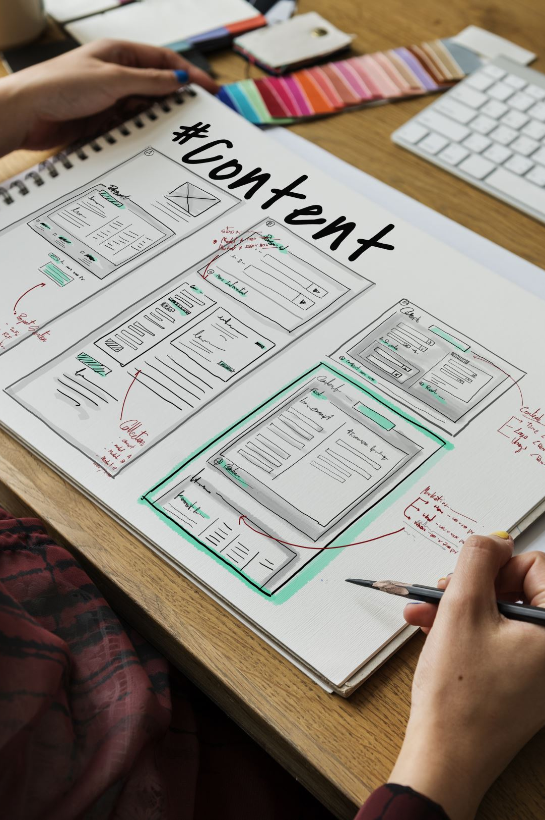
System Design Overview
Web-based application architecture
Simple and interactive user interface
Category-wise expense management
Real-time calculation and analysis

Slide 12
Design and Development of Basic Model
Frontend developed using HTML for structure
CSS used for styling and layout
JavaScript used for logic and calculations
Data processed dynamically in browser

Slide 13
Basic Model Features
Add, edit, and delete expenses
Automatic calculation of total expenses
Category-wise expense display
Identification of high spending areas

Slide 14
Conclusion
Smart Expense Tracker helps manage finances effectively
Reduces unnecessary spending
Encourages better budgeting and saving habits
Suitable for students and individuals

Slide 15
THANK YOU

